Slide 1
Basic Programming
SUMMARIZED
UTM KUALA LUMPUR

Slide 2
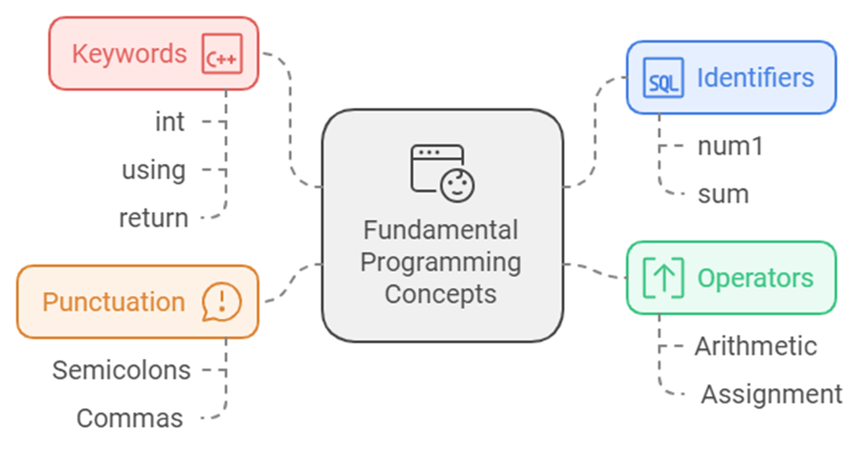
Fundamental Concepts in Programming
2

Slide 3
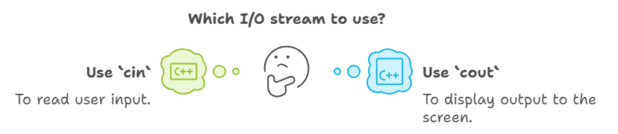
Input and Output Operations
3

Slide 4
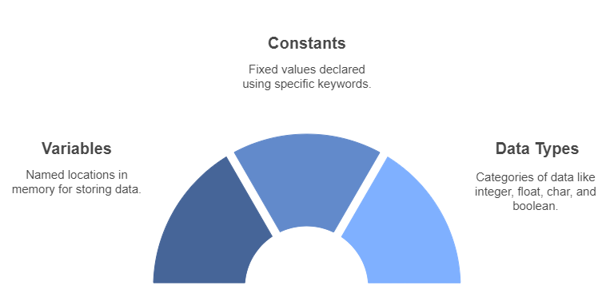
Variables and Data Types
4

Slide 5
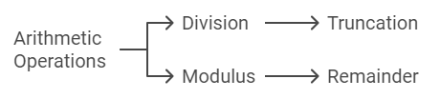
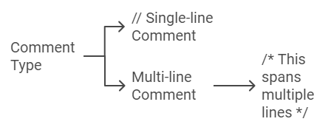
Control Structures, Best Practices and Exercises
5

Slide 6
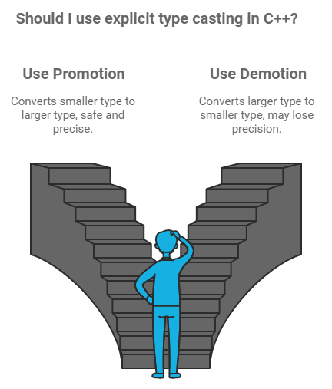
Type Conversion and Overflow
Automatic Type Conversion: Lower types are promoted to higher types when necessary.
Overflow and Underflow: Occur when the variable's capacity is exceeded.
Promotion: Converts a smaller type to a larger type (e.g., int to float).
Demotion: Converts a larger type to a smaller type (e.g., double to int), often losing precision.
int a = 5;
double b = 2.5;
double result = a + b; // 'a' is promoted to double
cout << "Result: " << result << endl; // Output: 7.5
6

Slide 7
Sample Code
#include <iostream>
using namespace std;
int main() {
double num1 = 5, num2 = 12, sum;
sum = num1 + num2;
cout << "The sum is " << sum;
return 0;
}
#include <iostream>
using namespace std;
int main() {
char letter;
letter = "Z"; // Error: Should be 'Z'
cout << letter << endl;
return 0;
}
cout << "Enter a number: ";
cin >> num;
int a = 5, b = 2;
double result = static_cast<double>(a) / b; // Convert 'a' to double
cout << "Result: " << result << endl; // Output: 2.5

Slide 8

Thank you for your participation. I am very grateful to have the opportunity into this sharing session. If there any enquiries, feels free to contact me.
+013 509 9215
khatibsyarbini@utm.my

